Slide 1


Sgt Leigh Ann Hester
Hester's squad was shadowing a 30-truck supply convoy when it was attacked in Salman Pak, Iraq. Hester maneuvered her team through the kill zone and into a flanking position while taking fire from AK-47 assault rifles, RPK machine guns and rocket propelled grenades (RPG). Sgt Hester and another sergeant then assaulted and cleared two a trench lines which insurgents were using as cover. During the 25-minute firefight, the team was credited with 27 insurgents killed, six insurgents wounded, and one captured. Sgt Hester, Sgt Nein, and Spc Mike (combat medic) were awarded Silver Stars for their valor.
Sgt Hester’s Silver Star was later upgraded to the Distinguished Service Cross, second only to the Medal of Honor.

Slide 2
Math 152 – Lesson 20/21
Lesson | Topic | Reading
19 | Modeling w/ Diff Eq/Dir Fields | 9.1/9.2
20/21 | Separable Equations | 9.3
22 | Models for Population Growth | 9.4
Objectives:
Determine if a differential equation is separable
Solve separable differential equations & apply initial conditions
Model and solve mixing problems using differential equations

Slide 3
Direction Fields
Suppose we are asked to sketch the graph of the solution of the initial-value problem
y ′ = x + y y(0) = 1
We don’t know a formula for the solution, so how can we possibly sketch its graph? Let’s think about what the differential equation means.

Slide 4
Direction Fields
The equation y ′ = x + y tells us that the slope at any point (x, y) on the graph (called the solution curve) is equal to the sum of the x- and y-coordinates of the point (see Figure 1).

Slide 5
Direction Fields
In particular, because the curve passes through the point (0, 1), its slope there must be 0 + 1 = 1. So a small portion of the solution curve near the point (0, 1) looks like a short line segment through (0, 1) with slope 1. (See Figure 2.)

Slide 6
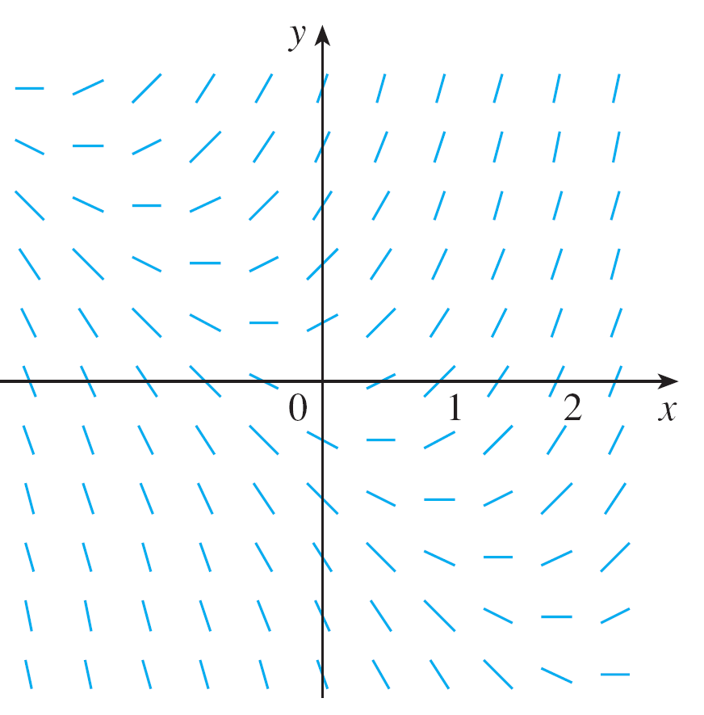
Direction Fields
As a guide to sketching the rest of the curve, let’s draw short line segments at a number of points (x, y) with slope x + y. The result is called a direction field and is shown in Figure 3.

Slide 7
Direction Fields
Section 9.2

Slide 8
Solution

Slide 9
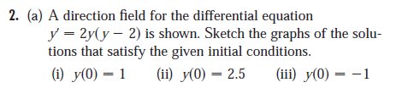
Board Work
Section 9.2

Slide 10
Solutions

Slide 11
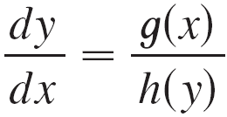
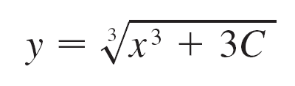
Separable Equations
Separable Eqns works on first-order differential equations like:
This equation can be separated into a function of x and a function of y
Example:
y² dy = x² dx

Slide 12

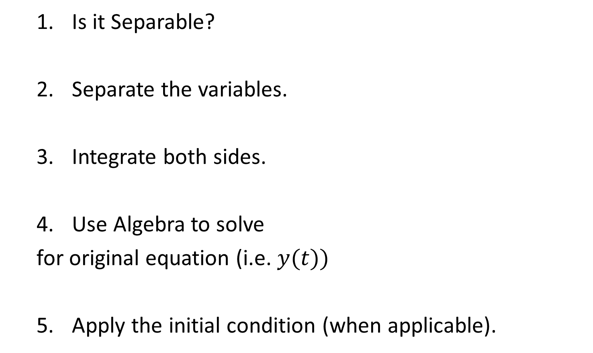

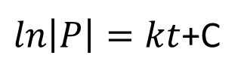


Separable Equations
Is it Separable?
Separate the variables.
Integrate both sides.
Use Algebra to solve
for original equation (i.e. $y(t))$
5. Apply the initial condition (when applicable).
$$\frac{dP}{dt}=kP$$
$$\frac{1}{P} dP=k dt$$
$ln\left|P\right|=kt$+C
$$\left|P\right|=e^{(kt+c)}=e^{kt}e^{c}$$
$$P=±De^{kt}$$
Notes:
Is it separable? This ONLY works for FIRST order diffy-Q’s! Dy/dx = , or y’ =
Can you separate the variables?
C is an arbitrary constant…each step is different, so “C1, C2, C3…” or “A, B, C….” don’t get confused
ALGEBRA!!
“General equation” becomes a “Specific Equation” after applying initial conditions.

Slide 13



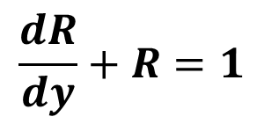

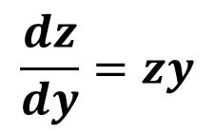
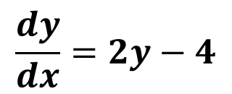



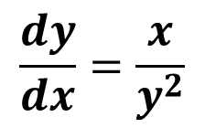

Board Work
$$\frac{dz}{dy}=zy$$
$$1.$$
$$z=3 when y=0$$
$$\frac{dy}{dx}=\frac{x}{y^{2}}$$
$$2.$$
$$y\left(0\right)=2$$
$$\frac{dR}{dy}+R=1$$
$$3.$$
$$R\left(1\right)=0.1$$
$$4.$$
$$\frac{dy}{dx}=2y−4$$
$$Through the Point (1,5)$$

Slide 14

Answers
1.
2. $\frac{dy}{dx}=\frac{x}{y^{2}}$ $y\left(0\right)=2$ $y^{}$ = ${(\left(\frac{3}{2}\right)x^{2}+8)}^{(\frac{1}{3})}$
3.
4. through (1,5)

Slide 15
Backups

Slide 16
BW #1

Slide 17
BW #2

Slide 18
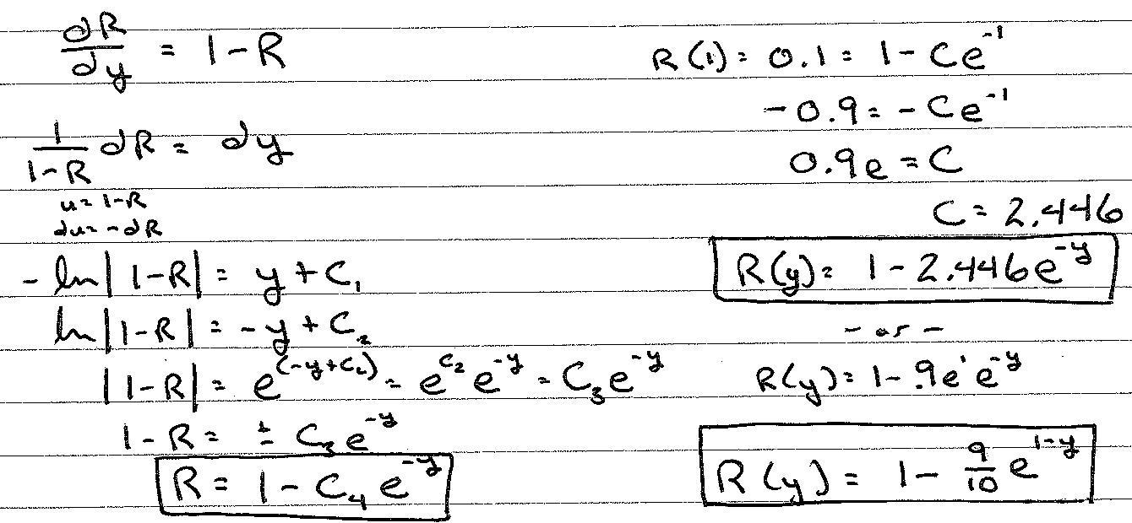
BW #3
Notes:
1-(9e/10)e^(-x) -or- 1-(9/10)e^(1-x)
same-same

Slide 19
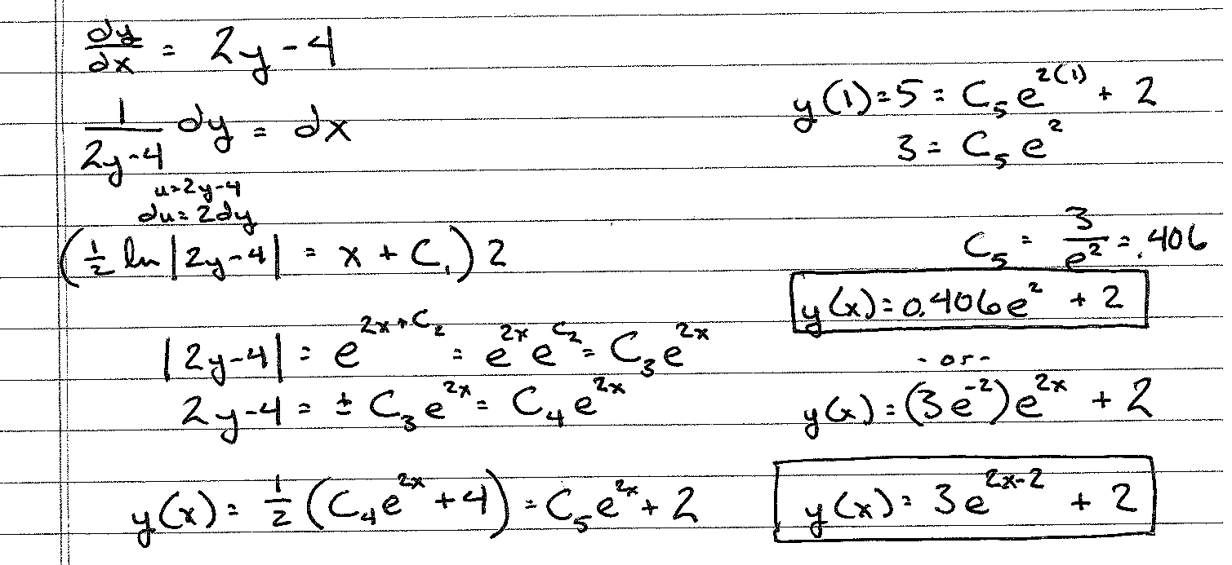
BW #4
x
Notes:
(3/e^2)e^(2x)+2 -or- 3e^(2x-2)+2

Slide 21
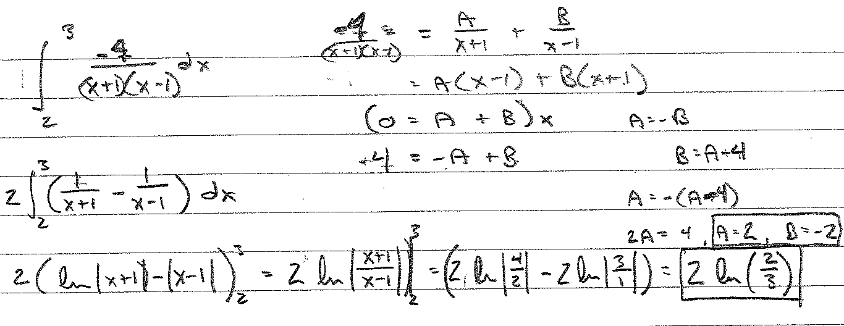
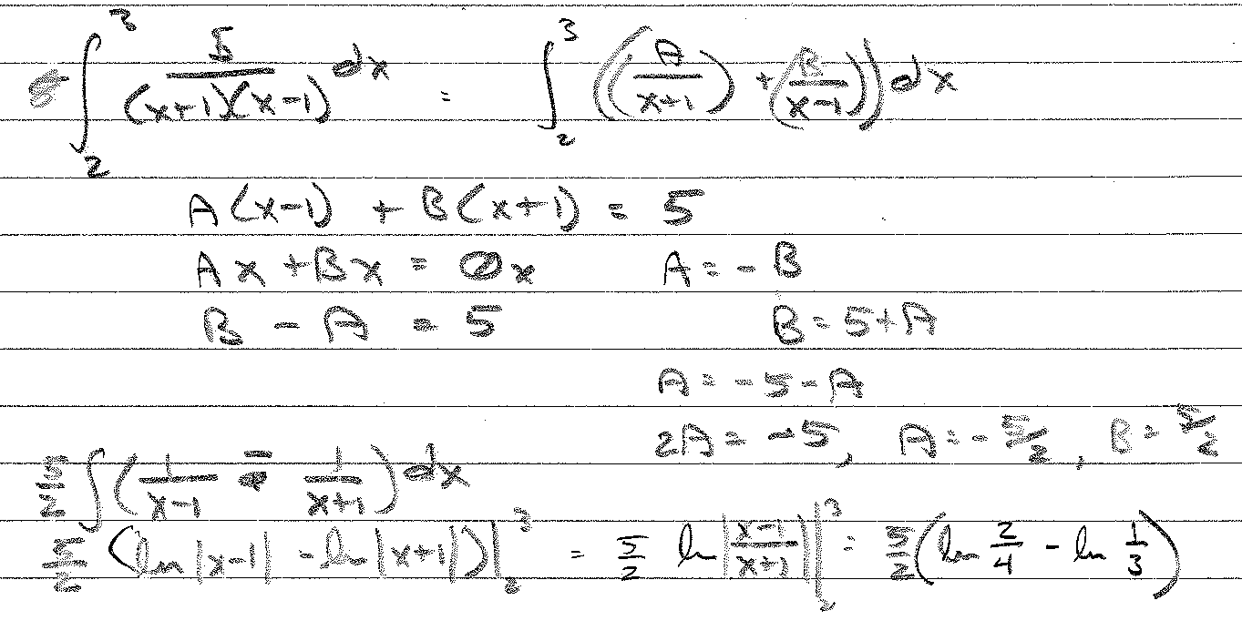
HWS2, #4

Slide 23
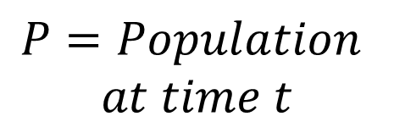

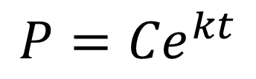
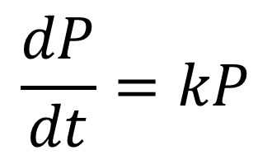
Modeling with Differential Equations
Model: Over time, population grows at a rate proportional to the size of the population.
Variables:
Differential Equation:
$$\frac{dP}{dt}=kP$$
$$t=Time$$
$$P=Population$$
$$at time t$$
General Solution:
$$P={Ce}^{kt}$$

Slide 24
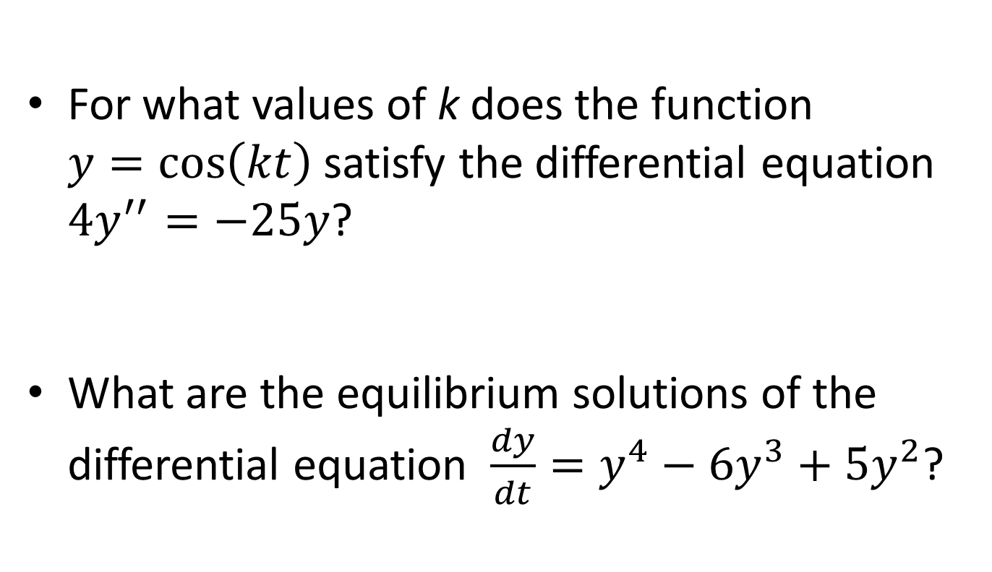
Board Work
For what values of k does the function $y=\cos\left(kt\right)$ satisfy the differential equation $4y^{′′}=−25y$?
What are the equilibrium solutions of the differential equation $\frac{dy}{dt}=y^{4}−6y^{3}+5y^{2}$?
Notes:
+- 5/2
Y^2(y-1)(y-5)

